Slide 1
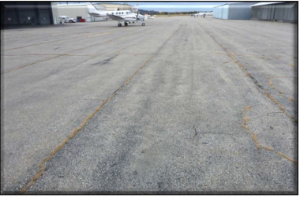
Airfield Pavement Condition Reports and Pavement Management Training

Slide 2
Agenda
Purpose of the training
  Why PCI’s are important
FAA Assurance
Pavement Condition Index
  Procedure to date
  Network Definitions - Branches, Sections, Samples ~ Naming
Evaluations
Stresses
Reading the report
  General Information
  Specific Information
Creating a Pavement Management Plan

Slide 3
Purpose of the training
  FAA Staff has been requesting airports to develop Pavement Management Plans.
  Grant assurances require Sponsors to have a Pavement Management Plan.
  Sponsors are responsible for airport maintenance.
  MaineDOT accomplished the first big step and “just handed out the resultant reports”.
  Teach Sponsors and other users how to read and understand the report.
  Teach Sponsors how to create a Pavement Management Plan.

Slide 4
Purpose of the training
  Why are PCI’s important
  Consistency
  Statewide
  New England Region
  Nationally
  Objective
  “By the numbers” / measured
  Defendable

Slide 5
FAA Assurance
C. Sponsor Certification
  11. Pavement Preventive Maintenance. With respect to a project approved after January 1, 1995, for the replacement or reconstruction of pavement at the airport, it assures or certifies that it has implemented an effective airport pavement maintenance-management program and it assures that it will use such program for the useful life of any pavement constructed, reconstructed or repaired with Federal financial assistance at the airport. It will provide such reports on pavement condition and pavement management programs as the Secretary determines may be useful.

Slide 6
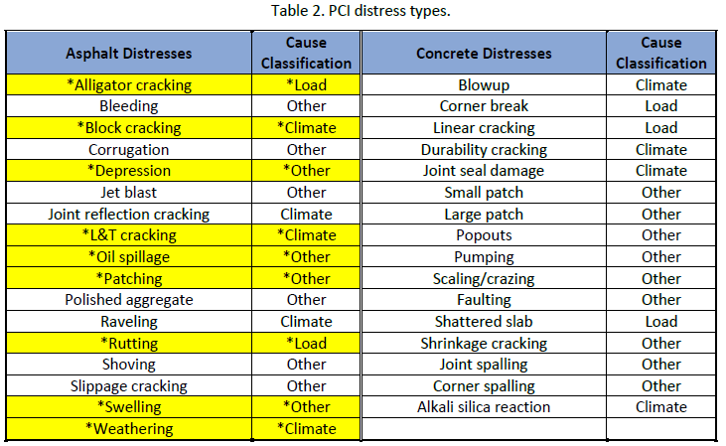
Pavement Condition Index
Standardized Procedures
  American Society for Testing and Materials (ASTM-5340-20)
    Standard Test Method for Airport Pavement Condition Index Surveys
Based on measurements of pavement distresses and severity
          Low
            Medium
            Severe

Slide 7
Procedure to date
MaineDOT Contracted for Statewide PCI Measurements and Reporting
  All airport Branches, Sections and Samples have been created
  All measurements taken
  All individual reports created and “just handed out”
  Statewide Pavement Management Software (PAVER) loaded with data
  Cost Estimating included in Paver
  Proposed maintenance plans created for each Sponsor included in plans including rough estimates
    Estimates for Construction only (does not include design / construction engineering side of things)
FAA has started asking for Pavement Management Plans

Slide 8
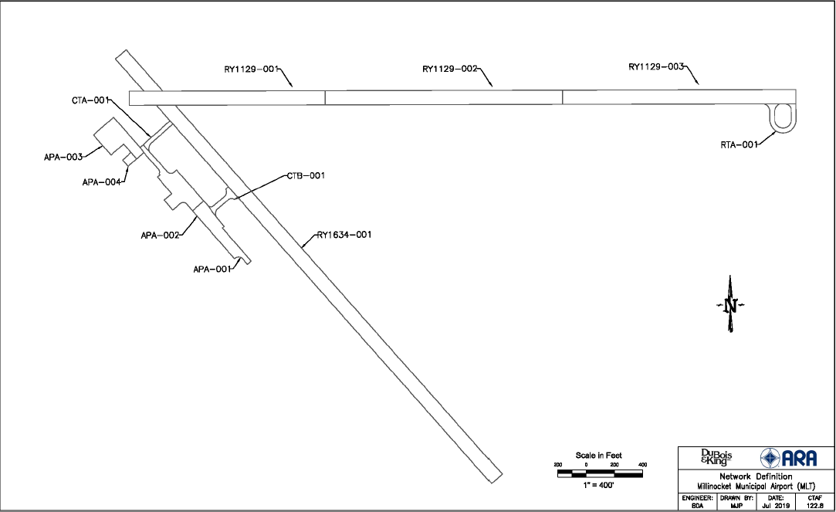
Network Definitions - Branches, Sections, Samples ~ Naming

Slide 9
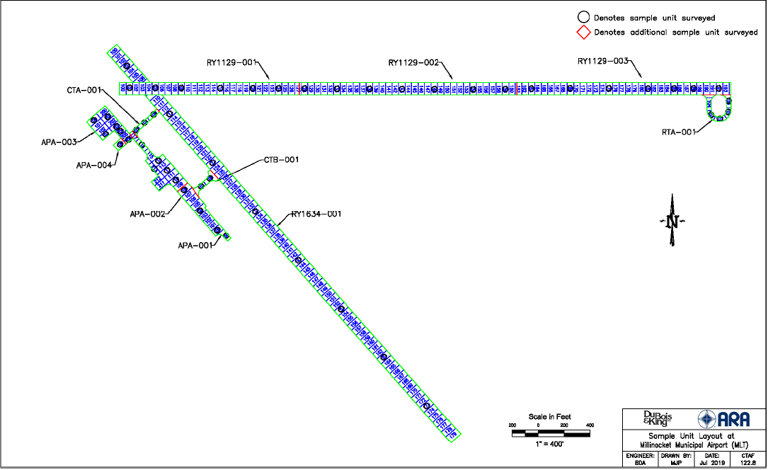
Network Definitions - Branches, Sections, Samples ~ Naming

Slide 10
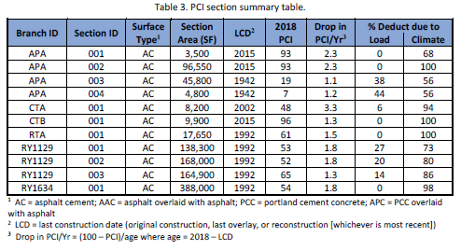
Evaluations

Slide 11
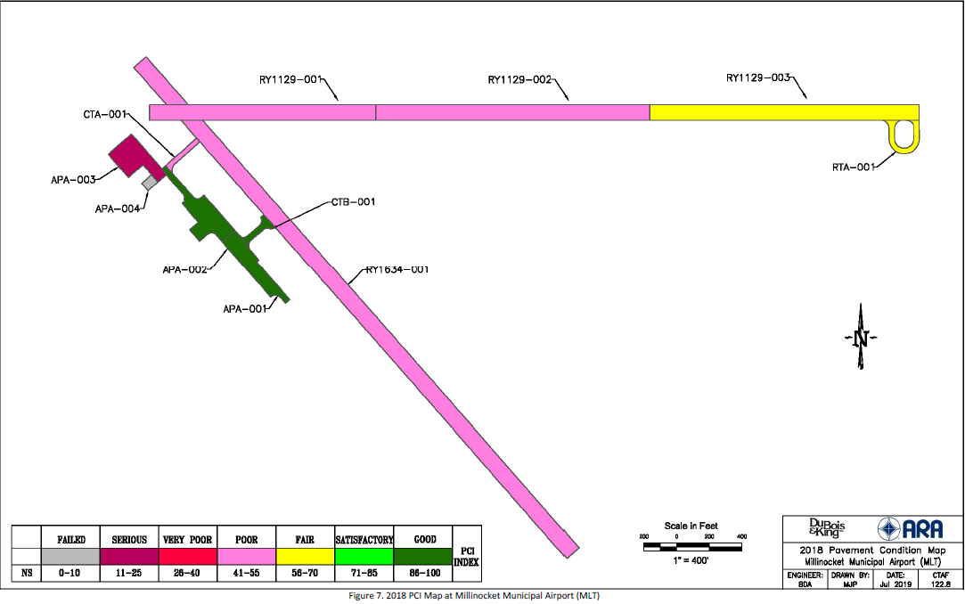
Evaluations

Slide 12
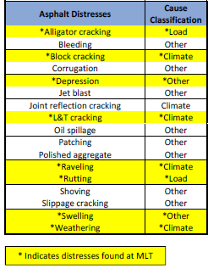
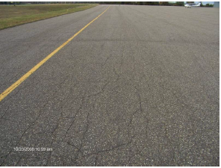
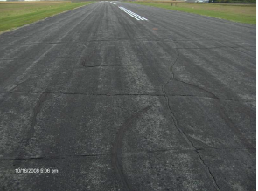
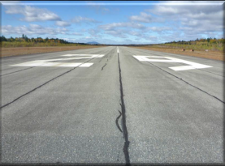
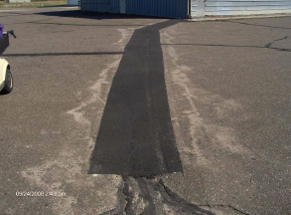
Stresses
Each Book has examples at the end of the book

Slide 13
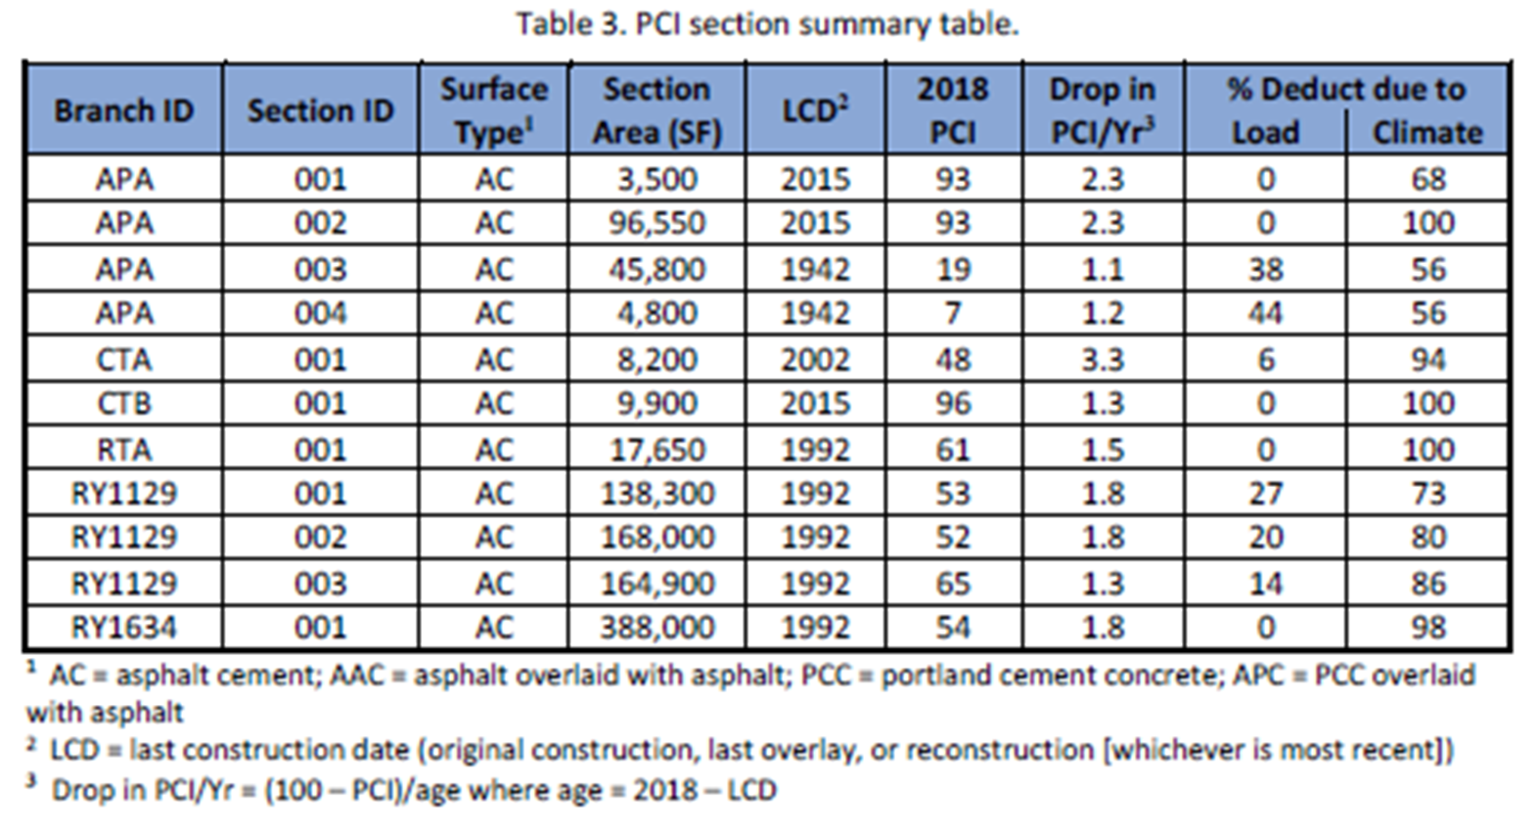
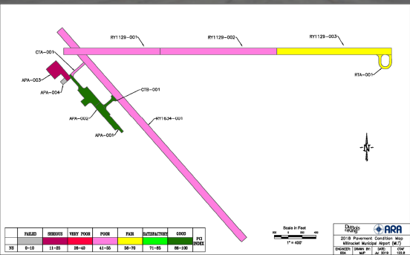
Reading the report
General information
    Branch/Section averages based on roughly 10% of individual areas

Slide 14
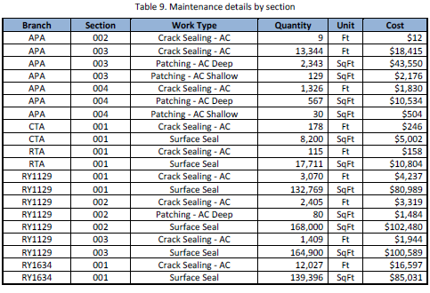
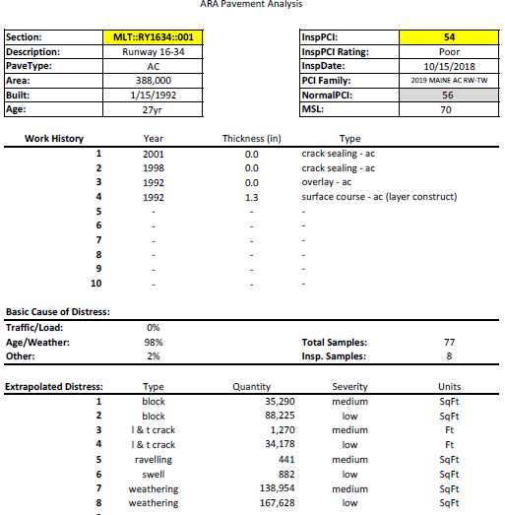
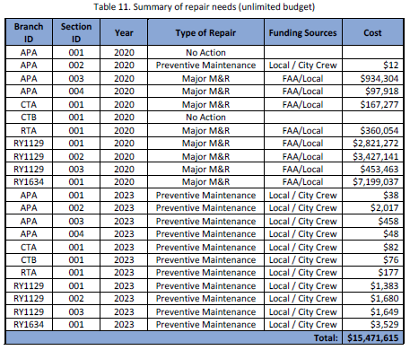
Reading the report
Specific Information

Slide 15
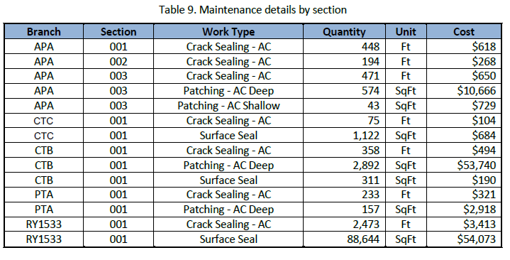
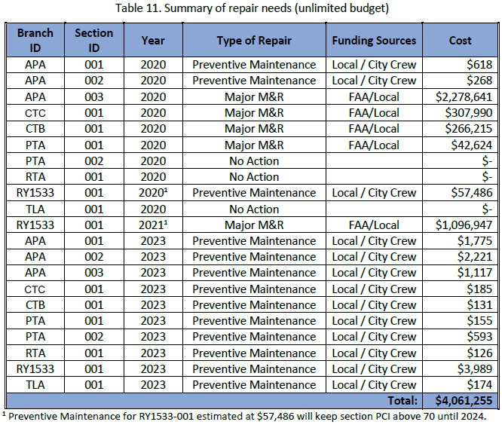
Creating a Pavement Management Plan

Slide 16
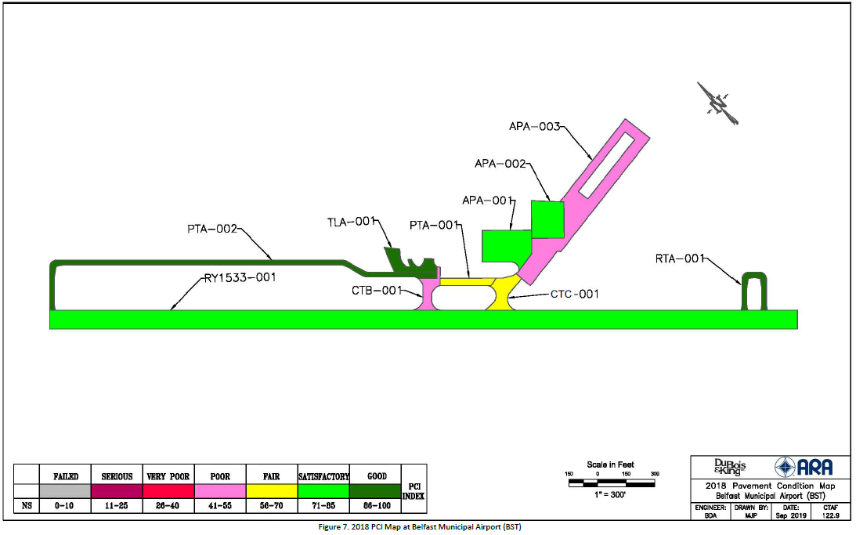
Creating a Pavement Management Plan

Slide 17
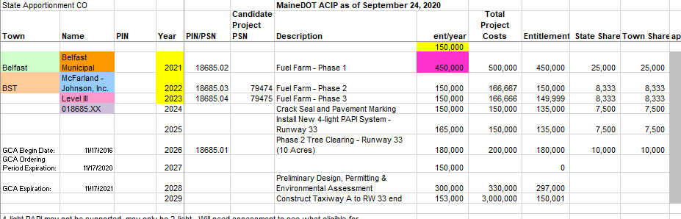
Creating a Pavement Management Plan

Slide 18
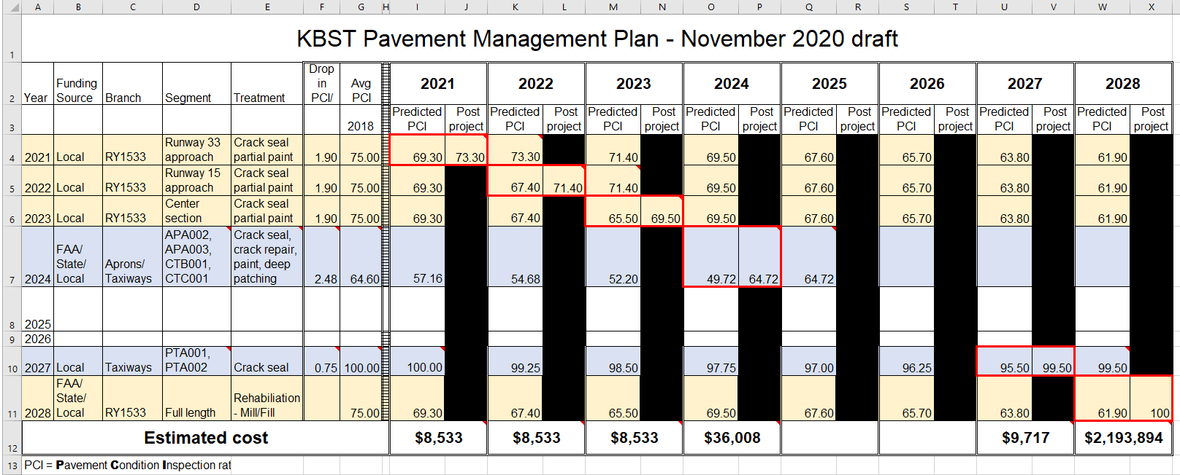
Creating a Pavement Management Plan

